Slide 1
The Complete Front-End Development course
HTML5

Slide 2
Module 2
Document Structure
HTML syntax
HTML5 semantic and essential tags
Lists
Images
Hyperlinks
Tables
Forms
DIV- Layout
Separate content for CSS styling
Classes, ID
iframes
Graphics
Media
APIs- Geolocation, Web Storage, Web Workers, Drag and Drop, Server-Sent Events
HTML best practices- HTML vs XHTML

Slide 3
HTML5
HTML- Hyper Text Markup Language
HTML is a Markup language rather than a Programming language
HTML Versions- HTML 1.0, HTML 2.0, HTML 3.2, HTML 4.01, HTML5
W3C (World Wide Web Consortium), and WHATWG( Web Hypertext Application Technology Working Group) are involved in the development of HTML 5
Platform-independent
Documentation- MDN, devdocs.io.
Notes:
1. Go to codepen, create your own book to note everything you learn here.
2. Understanding from documentation is an important skill. So is googling.
3. Emojis windows+. For MAC- CTRL + CMD + Space

Slide 4
Document Structure
Which browser to give importance while developing?
Test your code in all major browsers
<html>
<head>
<body>
<title>
<h1>
<p>
<meta>
Attribute “id”
Notes:
Install VS code and extensions reminder
IE, Edge, free- Chrome (higher security), firefox.
Can use codepen, jsfiddle, jsbin etc
Add html boilerplate in VS code

Slide 5
Your first HTML code
<!DOCTYPE html>
<html>
<head>
<title>First Title</title>
<meta charset="UTF-8">
</head>
<body>
<h1>First Heading</h1>
<p id=“firstp”>First paragraph.</p>
</body>
</html>
<html>
<head>
<body>
<title>
<h1>
<p>
<meta>
Attribute “id”

Slide 6
Understanding the Head
<html lang="zxx">
<meta charset="UTF-8"> otherwise Mojibake.
<meta name="description" content=“Skill-Lync Masters’ course">
<meta name="viewport" content="width=device-width, initial-scale=1.0">
Supporting files-<link rel="icon" type="image/png" href="images/flavicon.png">
Notes:
Show Mojibake on firefox - https://www.joelonsoftware.com/2003/10/08/the-absolute-minimum-every-software-developer-absolutely-positively-must-know-about-unicode-and-character-sets-no-excuses/
Unicode-table.com everything including all emoji
3. If nothing mentioned about small devices in css media queries, then phones zoom out the website to fit content properly on its browser.
IF you don’t want zooming out like this, add meta tag with name viewport and content width=device-width and initial-scale=1.
Use beautifier in VS code
lang attribute inside the <html> tag, to declare the language of the Web page. This is meant to assist search engines and browsers
zxx is a code of the ISO 639-2 and ISO 639-3 standards of language acronyms meaning "no linguistic content".

Slide 7
Document Object Model
<html>
<head>
<body>
<title>
<h1>
<p>
<meta>
Attribute “id”

Slide 8
Anatomy of HTML syntax
Element
Start Tag <p>
Content
This is my first paragraph
End Tag </p>
Attribute1
Id=“firstp”
Attribute2
Class=“para”
Tags, Attribute
Notes:
Interview Question- Difference between Element and tag.

Slide 9
Some common tags
html
head
title
body
h1-h6
p
br
hr
pre
<!-- comment -->

Slide 10


Inline and block level
A block-level element always starts on a new line and takes up the full width available (stretches out to the left and right as far as it can). Eg div
An inline element does not start on a new line and it only takes up as much width as necessary. Eg. span

Slide 11
Inline and block level
Interview Question- What is the difference between a block-level element and an inline element? Give examples of both
An inline element cannot contain a block-level element.

Slide 12
Anchor Tag
<a href="https://skill-lync.com/">Industry relevant advanced courses for Engineers</a>
Title attribute so that screen readers can read for visually impaired.
Anchor tag is both an inline and a block level element in html5 i.e phasing and flow control but only inline in html 4.
<a href="mailto:someone@example.com">Send email</a>

Slide 13
Hyperlinks
Target Attribute
_self
_blank
_parent
_top
Four states of a link and its different styles-
Unvisited
Hover
Visited
Active

Slide 14
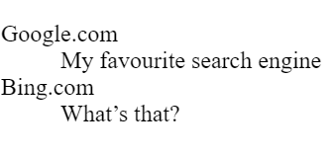
Lists
Ordered, Unordered and Definition Lists
Definition List-
Notes:
<dl> <dt>Google.com</dt> <dd>- My favourite search engine</dd> <dt>Bing.com</dt> <dd>- What’s that?</dd> </dl>

Slide 15
Unordered List
list-style-type
Disc
Circle
Square
none

Slide 16
Ordered list
list-style-type
"1”
"A”
"a”
"I”
"i"

Slide 17
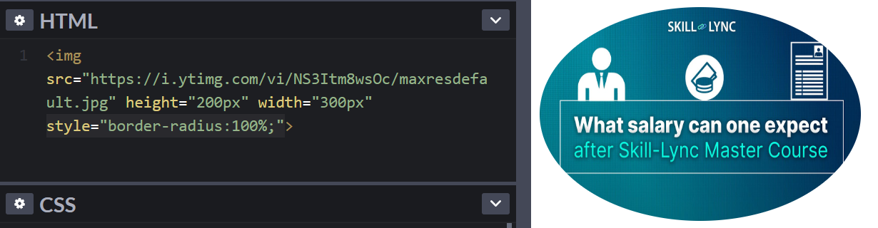
Images
The img tag
Add images from source- A URL or Local file.
The picture tag
Need circular images?- Use style="border-radius:100%;” or crop-circle.imageonline.co
Notes:
Always put width and height of image so that the space is reserved even if image doesn’t load on time and the page doesn’t be jumpy
<picture> <source media="(min-width: 650px)" srcset="img_food.jpg"> <source media="(min-width: 465px)" srcset="img_car.jpg"> <img src="img_girl.jpg"> </picture>
Dev tools- network- throttling means purposely causing it to load at a lower bandwidth to see page slow load effects
Show jumpy image without height and weight

Slide 18
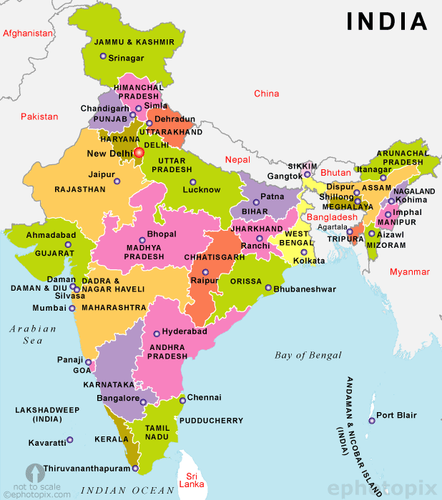
Image maps
<img src=“india.jpg" alt=“Map of India" usemap="#indiamap">
<map name=“indiamap">
<area shape=“rect" coords="34,44,270,350" alt=“Mumbai" href=“Mumbai.htm">
<area shape=“circle" coords="290,172,333,250" alt=“Chennai" href=“Chennai.htm">
<area shape="circle" coords="337,300,44" alt=“Delhi" href=“Delhi.htm">
</map>

Slide 19

Tables
thead and tbody
Using Tables for Layout
Cellpadding, Cellspacing
Rowspan, Colspan
Caption
Notes:
<table style="width:100%"> <tr> <th>Firstname</th> <th>Lastname</th> <th>Age</th> </tr> <tr> <td>Jill</td> <td>Smith</td> <td>50</td> </tr> <tr> <td>Eve</td> <td>Jackson</td> <td>94</td> </tr> </table>

Slide 20
Forms
Enctypes
Action: mailto
Inputs
Select
Buttons
Checkboxes
Radio
Date
File
Color
Number
Password
Text
Submit
Fieldset, legend
Other new tags
Datalist
Notes:
Eg skill lync website form
<select id="cars" name="cars“size="4" multiple> <option value="volvo">Volvo</option> <option value="saab">Saab</option> <option value="fiat">Fiat</option> <option value="audi">Audi</option> </select>
<textarea name="message" rows="10" cols="30"> The cat was playing in the garden. </textarea>
<button type="button" onclick="alert('Hello World!')">Click Me!</button>
<form action="/action_page.php"> <input list="browsers"> <datalist id="browsers"> <option value="Internet Explorer"> <option value="Firefox"> <option value="Chrome"> <option value="Opera"> <option value="Safari"> </datalist> </form>
<form action="/action_page.php"> <fieldset> <legend>Personalia:</legend> <label for="fname">First name:</label><br> <input type="text" id="fname" name="fname" value="John"><br> <label for="lname">Last name:</label><br> <input type="text" id="lname" name="lname" value="Doe"><br><br> <input type="submit" value="Submit"> </fieldset> </form>

Slide 21
Other Input types
Why so many types?
<input type="email">
<input type="image">
<input type="range">
<input type="reset">
<input type="search">
<input type="time">
<input type="url">
<input type="hidden">

Slide 22
Form attributes
value
readonly
disabled
maxlength
min="1" max="5“
multiple
placeholder
required
autofocus
autocomplete

Slide 23
HTML5 other essential tags
b
em
i
small
strong
sub
sup
ins
del
mark
Font tag is not supported in HTML5, but present in HTML4

Slide 24
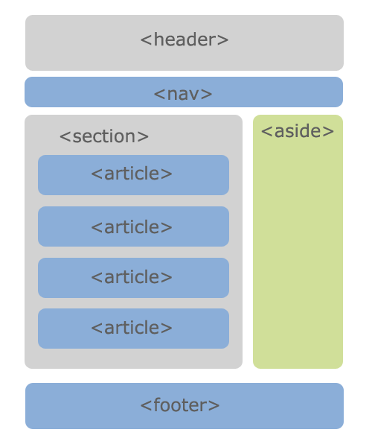
HTML5 semantic tags
Interview Question- What’s the difference between semantic and non semantic tags in HTML5?

Slide 25
Color representations
RGB(0,0,0)-RGB(255, 255, 255)
#000000- #ffffff (#RRGGBB)
hsl(hue, saturation, lightness)

Slide 26

DIVs- Layout
Separate content for CSS styling

Slide 27
Classes, ID
Multiple HTML elements can share the same class. An element can have multiple classes.
Value for ID should be unique in the entire HTML document.
Classes used mostly for CSS styling. ID used mostly for scripting.
Use of ID in Single Page Applications- <a href="#C4">Jump to Chapter 4</a>

Slide 28


iframes
A web page within a web page.
Notes:
<iframe src=“1.html" height="200" width="300"></iframe>
Frame and frameset used in html4 but not in html5 now.

Slide 29
Graphics- Canvas
<canvas> - Draws 2D graphics with JavaScript on a web page.
Canvas- no border, no content. Only a container for graphics.
JavaScript required to draw the graphics.
ID attribute - referred in the script. A width and height attribute defines the size of the canvas. Style attribute for border.
Good for graphic-intensive games
Notes:
<canvas id="myCanvas" width="200" height="100"></canvas>
<canvas id="myCanvas" width="200" height="100" style="border:1px solid #000000;"> </canvas>

Slide 30
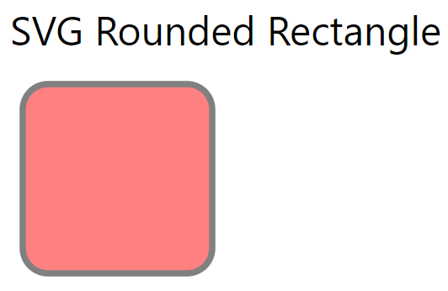
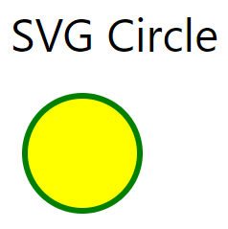
Graphics- SVG
SVG - Scalable Vector Graphics
To define graphics for the Web
SVG- describes 2D graphics in XML.
SVG good for applications with large rendering areas eg Google Maps, and which need support of event handlers.
Notes:
<svg width="100" height="100"> <circle cx="50" cy="50" r="40" stroke="green" stroke-width="4" fill="yellow" /> </svg>
<svg width="400" height="180"> <rect x="50" y="20" rx="20" ry="20" width="150" height="150" style="fill:red;stroke:black;stroke-width:5;opacity:0.5" /> </svg>

Slide 31
Media
Add Audio and Video files to play on your webpage.
What about Plugins?
Use media only to enhance content.
Fallbacks-
<object width="100%" height="500px" data="snippet.html"></object> or <object data="audi.jpeg"></object> OR
<embed src="audi.jpeg"> Or <embed width="100%" height="500px" src="snippet.html">
Notes:
Plugins?- in case html5 media doesn’t work. However most browsers don’t support plugins. So can use object tag which was used to include plugins to include image or another html snippet or embed tag for the same.

Slide 32
Adding Youtube videos
Upload the video on YouTube. Check the youtube embed script.
<iframe src=“videoURL”>
Use the width and height attributes to specify the dimension of the player
Add other parameters to the URL as required- <iframe width="560" height="315" src="https://www.youtube.com/embed/L4GPkB2n9Gg" frameborder="0" allow="accelerometer; autoplay; encrypted-media; gyroscope; picture-in-picture" allowfullscreen></iframe>

Slide 33
Geolocation
For rendering maps, giving certain services based on location.
getCurrentPosition() method is used in the script to gain this information.
What about users’ privacy?
Notes:
For ecommerce site Change currency of ecommerce website based on the location. And the shipping charges information.
Also justdial, google maps suggestions of nearby places etc

Slide 34
Web Storage
With web storage, web applications on loading, can store data within the user's browser locally.
Better than cookies.
window.localStorage- stores data without expiry
window.sessionStorage- stores data only for one session
Interview question- What are the different types of Web Storage provided by HTML5? Explain the key differences between localStorage and sessionStorage objects.
Notes:
Eg. Storing the items in cart by a guest who is not logged in, to appear again if browser closed.
Before HTML5, application data had to be stored in cookies, included in every server request. Web storage is more secure, and large amounts of data can be stored locally (at least 5MB) and information is never transferred to the server. So without affecting website performance.
For sessionStorage, data lost when the browser tab is closed)

Slide 35
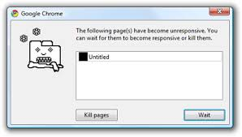
Web Workers
Ever experienced a page becoming unresponsive due to a script never finishing?
A web worker is a JavaScript that runs in the background, independently of other scripts, without affecting the performance of the page.
You can continue to use the application, while the web worker runs in the background.

Slide 36
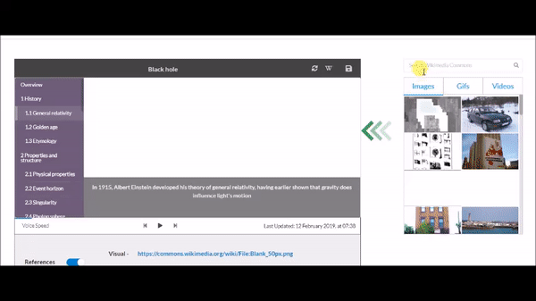
Drag and Drop
In HTML, any element can be dragged and dropped.
<img draggable="true">
Notes:
<img draggable="true" src="https://upload.wikimedia.org/wikipedia/commons/a/a3/VideoWiki_Drag_and_Drop_Editing_User_interface.gif">

Slide 37
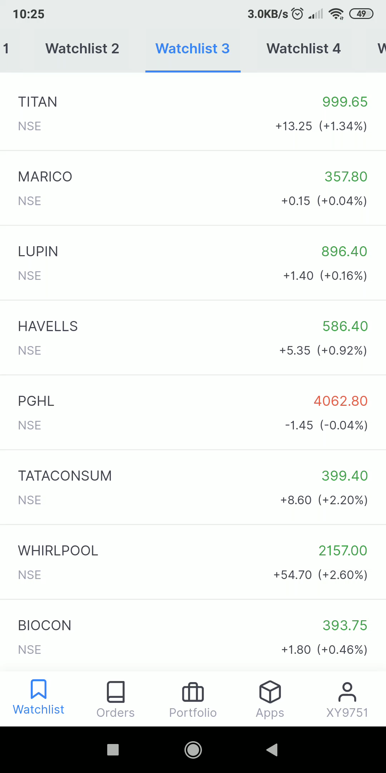
SS Event
Server-Sent Events (SSE) allow a web page to get updates from a server.
What’s new in this?
Examples: Facebook/Twitter updates, stock price updates, news feeds, sport results, etc.
Notes:
This was also possible before, but the user would have to cause an event to happen to ask if any updates were available eg button click, search bar etc. With server-sent events, the updates come automatically.

Slide 38
Application Cache
What’s a cache?
Application Cache- Introduced in HTML5.
Application is accessible without an internet connection after loading once.
Offline browsing
Speed
Reduced server load
A Manifest file is a simple text file, that tells the browser what to cache and what not to cache.
Notes:
It means that a web application is cached. Users can use the application even when they are offline.
Cached resources load faster as compared to content that gets downloaded, directly from the server
The browser will only download updated/modified resources from the server.

Slide 39
XHTML- Best practice
XHTML stands for EXtensible HyperText Markup Language. Rules for this is maintained by the W3C.
<!DOCTYPE> is mandatory
<html>, <head>, <title>, and <body> are mandatory
Elements must always be properly nested, closed, in lowercase, be quoted
Attributes should be in lowercase and minimization is forbidden
Use W3C validator for HTML5 errors

Slide 40
Summary
Document structure
Different Tags
Forms and inputs
Colors, classes and ids
Graphics
Media
HTML APIs
Best practices

Slide 41
Motivational tip
Struggle is good. Ramp up gracefully at a steady pace.
Demotivated? Little by Little, a little becomes a lot. – African Proverb
Practice makes perfect.
Notes:
https://web.stanford.edu/group/csp/cs21/htmlcheatsheet.pdf

Slide 42

Assignment
Create the html structure of the homepage as shown in the mockups using the provided images. Put descriptive comments. You can use other images from unsplash.com and flaticon.com

Slide 43
Answer the following Questions
How can we create links to different sections within the same web page?
What are the new features introduced in HTML5?
What would happen if the HTML Document does not contain <!DOCTYPE>?
What are all the various elements provided by HTML5 for media content?
What are the new Form elements made available in HTML5?
List the various semantic elements in HTML5?
What is a marquee?
Which browsers support HTML5?
Is HTML5 backward compatible with old browsers?

